Slide 1


Slide 2
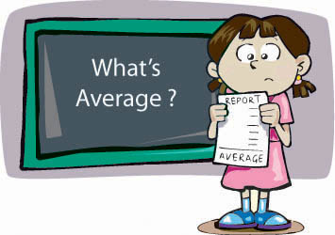
What is Average ??

Slide 3
Average = Sum of Observations
Number of Observation

Slide 4
FORMULAS
The average of consecutive numbers is always the middle number.
Average= Sum of observation/ No. of observation
Average of first n natural no. = n+1/2
Average of square of first n natural no. = (n+1)(2n+1)/6
Average of first n odd no. = n
Average of first n even no. = n+1
Average of consecutive no. = (first term + last term)/2

Slide 5

Examples
Q1.Find the average of following number:
1, 3, 5, 7, 9, 11, 13, 15, 17, 19, 21
A. 9
B. 11
C. 12
D. 13

Slide 6

Q2.The average of 20 numbers is zero. Of them, at the most, how many may be greater than zero?
A. 0
B. 1
C. 10
D. 19

Slide 7
Q.3 Find the average of 20,23,28,24,25
A)24
B)25
C)26
D)None

Slide 8

Q.4 Find the Averages of 61,70,67,77,103,90
A)78
B)88
C)98
D)None
Notes:
Ans 78

Slide 9

Q.5 Average of 5 students marks is 30 and one student having marks is 90, is added to the team , what is new average ?
A)40
B)50
C)60
D)None

Slide 10

Q.6 Average of 4 students marks is 50 and one student having marks has 200, is added to the team , what is new average ?
A)70
B)80
C)90
D)None

Slide 11

Q.7 Average of 6 students marks is 60 , what is the new average if a student of marks 110 is taken out ?
A50
B)55
C)60
D)None

Slide 12

Q.8 In class A there are 40 students whose average is 50 , and in class B there are 10 students whose average is 40 , then find the overall average?
A)48
B)50
C)58
D)None

Slide 13

Q.9 In class A there are 63 students whose average is 32, and in class B there are 21 students whose average is 44 , then find the overall average?
A)33
B)35
C)36
D)None

Slide 14
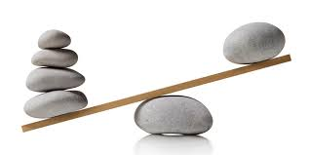
Q.10 In class A there are 40 students whose average is 50 , and in class B there are 10 students whose average is 40 , then find the overall average?
A)48
B)50
C)55
D)None

Slide 15
Q.11 The average age of 36 students in a group is 14 years. When teacher's age is included to it, the average increases by one. What is the teacher's age in years ?
A) 41 years
B) 51 years
C) 61 years
D) 71 years

Slide 16
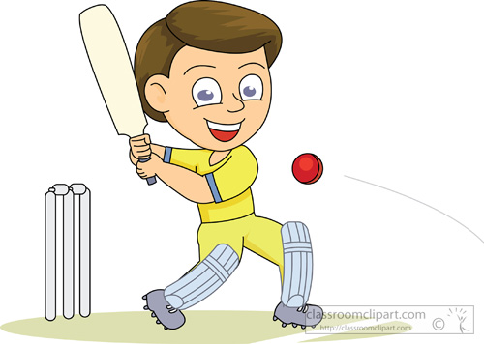
Q.12 In a first 10 overs cricket game run rate was 3.2. what should be runrate in the remaining 40 overs to reach the target 282 runs?
A)6.25
B)6.5
C)6.75
D)7

Slide 17
Q.13 The average weight of A, B and C is 45 kg. If the average weight of A and B be 40 kg and that of B and C be 43 kg, then the weight of B is:
A) 10 kg
B) 17 kg
C) 25 kg
D) 31 kg

Slide 18
Q.14 The average monthly income of P and Q is Rs. 5050. The average monthly income of Q and R is Rs. 6250 and the average monthly income of P and R is Rs. 5200. The monthly income of P is:
A) 3500
B) 4000
C) 4050
D) 5000

Slide 19
Q.15 A family consists of two grandparents, two parents and three grandchildren. The average age of the grandparents is 67 years, that of the parents is 35 years and that of the grandchildren is 6 years. What is the average age of the family?
A) 28 4/7 years
B) 31 5/7 years
C) 32 1/7 years
D) None of these

Slide 20
Q.16 A grocer has a sale of Rs. 6435, Rs. 6927, Rs. 6855, Rs. 7230 and Rs. 6562 for 5 consecutive months. How much sale must he have in the sixth month so that he gets an average sale of Rs. 6500?
A) 4991
B) 5991
C) 6001
D) None of these

